Slide 1
Motion Planning and Control in FRC
Jared Russell
Tom Bottiglieri
Austin Schuh

Slide 2
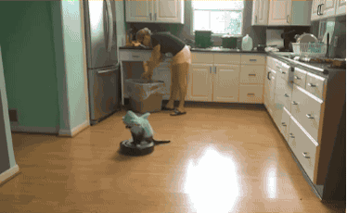
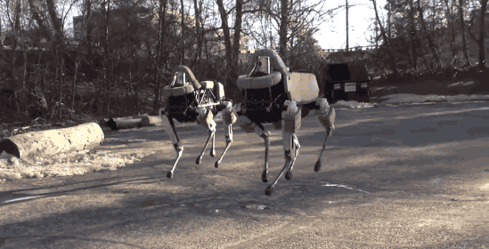
Why are we here?
Robots should move less like this
And more like this

Slide 3
Why are we here?
Control systems are fun
Software is where most of the hard problems in robotics are
Many of the techniques discussed today are common in industry
Motion control makes your FRC robot better!
Motivating examples...

Slide 4
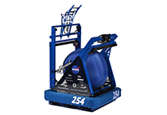
Go from here to there...

Slide 5
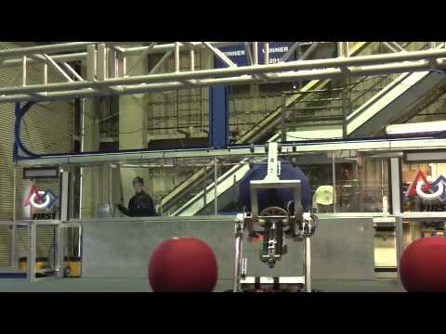
Coordinated motion...

Slide 6
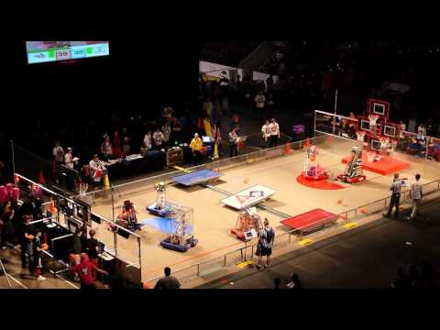
Vision-driven targeting...

Slide 7
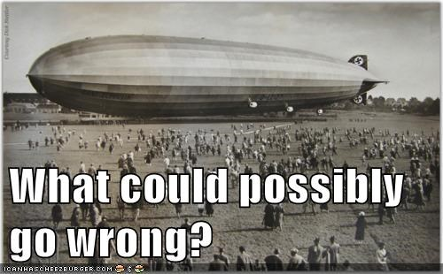
How can we do it?
(represents actual state of robot)
(represents desired state of robot)
Dead reckoning
254
Goal
10 Feet
Distance = 10 feet
Full Speed = 5 ft/sec
10 feet / 5 (ft / sec) = 2.0 seconds
Just drive at full speed for 2.0 seconds and we’ll be at the goal!

Slide 8
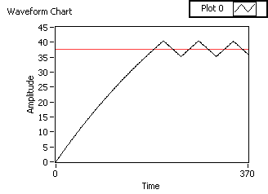
Let’s try using a sensor!
Dead reckoning
Bang-bang
254
Goal
10 Feet
while (true) {
error = goal_distance - current_distance
if (error > 0) {
Drive(1.0);
} else if (error < 0) {
Drive(-1.0);
} else {
Drive(0.0);
}
}
What is wrong with this code?

Slide 9
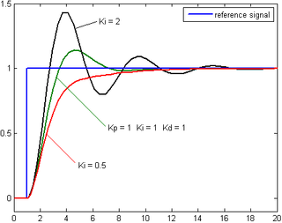
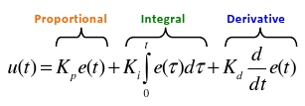
Slow down near the goal...
Dead reckoning
Bang-bang
PID
254
Goal
10 Feet
Slow down near the goal
Overcome friction
Add damping

Slide 10
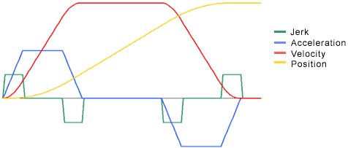
Take it one step further...
(represents desired intermediate state of robot)
Dead reckoning
Bang-bang
PID
Motion profiles
254
t =
.1 s
Goal
10 Feet
Smoothly accelerate
Cruise at full speed
Smoothly decelerate
A well-planned profile makes precise control easier!

Slide 11
Some quick definitions...
Paths and Trajectories
t = 0.1 s,
v = 0.5 m/s
t = 0 s, v = 0 m/s
index 1
index 0
index 2
t = 0.15 s,
v = 0.25 m/s
Path
index 3
Trajectory
t = 0.22 s
v = 0.28 m/s
index 6
index 4
t = 0.4 s,
v = 0.34 s
t = 0.26 s,
v = 0.3 m/s
index 5
t = 0.33 s,
v = 0.5 m/s

Slide 12
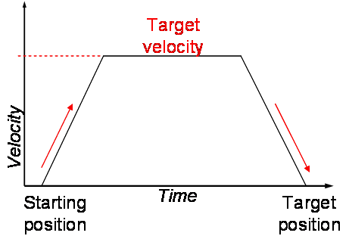
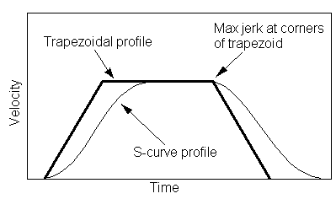
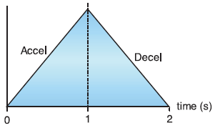
Some quick definitions...
Paths and Trajectories
Motion Profile

Slide 13
Some quick definitions...
Paths and Trajectories
Motion Profile
Feedforward and Feedback
Desired State of Motion
at time t = .1 s along the trajectory
Feedforward
at time t = .1 s, I should be going this fast
254
t =
.1 s
Goal
Feedback
at time t = .1 s, I should be there, but I am actually here, so I should go (faster/slower)

Slide 14
Some quick definitions...
Paths and Trajectories
Motion Profile
Feedforward and Feedback
Forward and Inverse Kinematics
Forward Kinematics
Joint space → Configuration space
“My left wheel went forward 2 inches, my right wheel went forward 4 inches” → I went forward while turning counter-clockwise
Inverse Kinematics
Configuration space → Joint space
“I want to turn clockwise 90 degrees” → Left wheel must go forward for X inches, Right wheel must go backward for X inches

Slide 15
The Motion Control Process
Figure out where you want to go
Find a path
Find a trajectory
Follow the trajectory
Figure out where you should be right now
Feedforward control +
Feedback control
Doing these sequentially is often simpler than doing them simultaneously

Slide 16
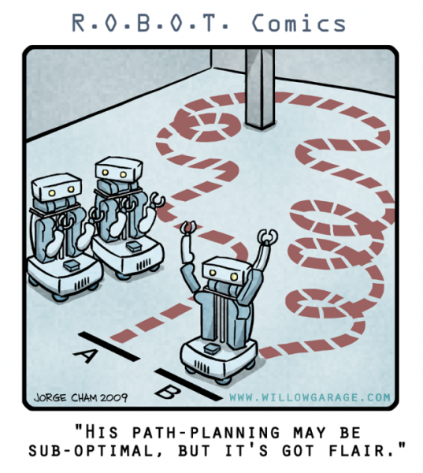
Path Planning
What is the sequence of configurations the mechanism will move through between start and goal?
The 1D case is usually trivial
...but the 2D (or more) case is interesting

Slide 17
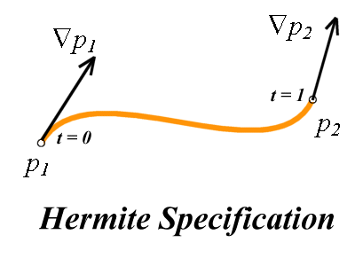
Simple Path Planning
Connect the dots - lots of ways to do it!
Curve fitting
Cubic splines
Quintic splines
Caveats
Loops
Overfitting
Spline fit code:
Team 254
Team 236

Slide 18
2D (Hermite) cubic spline fit
Inputs:
Start (x, y) at s = 0
End (x, y) at s = 1
Equations:
x(s) = A_{x} s³ + B_{x} s² + C_{x} s + D_{x}
y(s) = A_{y} s³ + B_{y} s² + C_{y} s + D_{y}
dx/ds(s) = 3A_{x} s² + 2B_{x} s + C_{x}
dy/ds(s) = 3A_{y} s² + 2B_{y} s + C_{y}
4 unknowns, 4 equations
Solve!
If you care about heading, you can choose these such that atan2(dy/ds(s), dx/ds(s)) = heading

Slide 19
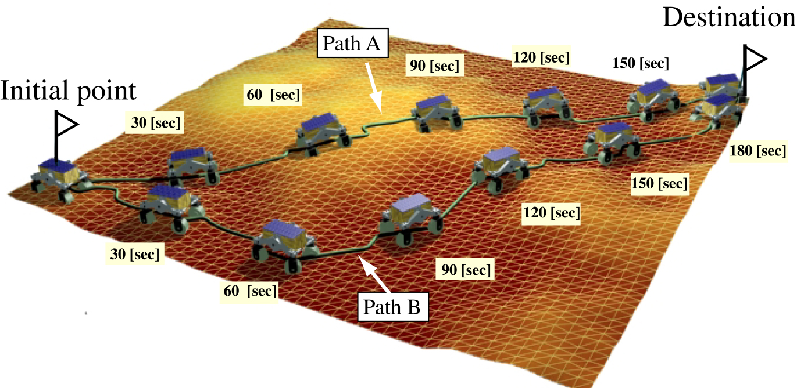
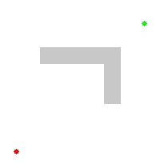
Advanced Path Planning
Active area of research in academia
Applications in robotics, video games, optimization and routing, etc.

Slide 20
Trajectory Generation
Ok, so we have a path. How fast should we traverse it? How do we:
Move to the goal as quickly as possible?
Obey constraints on maximum velocity, acceleration, (jerk)?
Know precisely where (and how fast) the mechanism should be moving at all points in time?
Here is one such approach...

Slide 21
Polynomial method for triangular or trapezoidal velocity profiles
Remember your kinematics:
v_{f} = v_{i} + a t
x_{f} = x_{i} + v t + ½ a t²
x_{f} = x_{i} + t (v_{i} + v_{f}) / 2
v_{f}² = v_{i}² + 2 a (x_{f} - x_{i})
There are up to three piecewise segments of motion in the motion (acceleration, cruise, deceleration)

Slide 22
v = v_cruise
Velocity
slope = acceleration = 0
slope = acceleration = max_accel
slope = acceleration = -max_accel
t = 0,
v = v_start
t = t_accel
t = t_cruise
t = t_decel,
v = v_end
Time
First step: Find the cruising velocity v_cruise

Slide 23
v = v_cruise
Velocity
slope = acceleration = 0
slope = acceleration = max_accel
slope = acceleration = -max_accel
t = 0,
v = v_start
t = t_accel
t = t_cruise
t = t_decel,
v = v_end
Time
First step: Find the cruising velocity v_cruise
Pretend there is no velocity limit: How fast could we go? (hint: distance to accel to v_cruise plus distance to decel to v_end must equal total distance)
v_cruise = Min(max_velocity, v_cruise)

Slide 24
v = v_cruise
Velocity
slope = acceleration = 0
slope = acceleration = max_accel
slope = acceleration = -max_accel
t = 0,
v = v_start
t = t_accel
t = t_cruise
t = t_decel,
v = v_end
Time
Next:
figure out how much distance you will cover to accelerate from v_start to v_cruise (hint: x_{f} = x_{i} + v t + ½ a t²)
...and the same to decelerate from v_cruise to v_end

Slide 25
v = v_cruise
Velocity
slope = acceleration = 0
slope = acceleration = max_accel
slope = acceleration = -max_accel
t = 0,
v = v_start
t = t_accel
t = t_cruise
t = t_decel,
v = v_end
Time
Finally:
How long are you at cruise velocity?
Total distance = distance during accel + distance during decel + distance during cruise
Notice that cruise distance is zero in the case of a triangular profile

Slide 26
The Result
We now have a function where we can lookup the desired position, velocity, and acceleration of the system for a given time t since the beginning of the motion

Slide 27
Alternative Approaches
Boxcar Filter Method
Inspired by signal processing
Use a chain of integrators to model rate constraints
Pros:
Fast, Doesn’t require floating point math
Can deal with limited jerk, snap, etc.
Cons:
Cannot deal with constraints that change over time
Only work for 1D problems
This is how the Talon SRX does its motion profiling
More information in this Chief Delphi thread

Slide 28
But that is a 1D trajectory… ...what about 2D+?
One simple approach:
At time t, figure out the current distance the robot should have covered
Figure out the arc length of the spline corresponding to this distance

Slide 29
Non-constant Constraints
A tank drive robot has coupled constraints
Can only translate so fast depending on curvature of path (because the outside wheel is the limiting factor)
v = (left_wheel_velocity + right_wheel_velocity) / 2
w = (right_wheel_velocity - left_wheel_velocity) / width_of_wheelbase
region of feasibility
angular velocity
translational velocity

Slide 30
Path
Curvature
Maximum Velocity
Velocity
Distance along path
Solution (Numerical Integration Approach):
Rather than computing switching times, divide the path up into discrete samples
For each sample, compute the maximum velocity based on curvature or other constraints

Slide 31
Maximum Velocity
Velocity
Distance along path
Next, starting at the beginning state, assign a velocity to each point that is Min(max_velocity, max_reachable_velocity)

Slide 32
Maximum Velocity
Velocity
Distance along path
One last step: Do the same thing from end to beginning

Slide 33
The Motion Control Process
Figure out where you want to go
Find a path
Find a trajectory
Follow the trajectory
Figure out where you should be right now
Feedforward control +
Feedback control

Slide 34
Trajectory Following
Figure out where you should be right now
1D case is easy
254
t =
.1 s
Goal
setpoint = LookUpSetpoint(t)
error = setpoint.pos - actual_position
2D navigation case
t =
.1 s
254
Along-track, cross-track, and heading components to error

Slide 35
Feedforward
Basic Idea
If you have information about your system, tell your controller!
Trajectories encode all the information necessary to tell a “perfect” robot to follow them exactly
The feedback part will take care of deviations from perfection

Slide 36
Trajectory Following
2. Feedforward control
254
t =
.1 s
Goal
setpoint = LookUpSetpoint(t)
SetMotorSpeed(Kv * setpoint.vel)
“Kv” is a velocity constant, representing a unit conversion between real-world velocities and motor speeds
Ex. a robot drive is measured to move at 10 ft/sec at full power
The resulting Kv is then 0.1 (so that a velocity setpoint of 1.0 results in full power)

Slide 37
Trajectory Following
2. (Better) Feedforward control
254
t =
.1 s
Goal
setpoint = LookUpSetpoint(t)
SetMotorSpeed(Kv * setpoint.vel + Ka * setpoint.acc)
“Ka” is an acceleration constant, telling your controller to add a little extra power to accelerate, and a little less to decelerate.
Easiest to tune by first tuning Kv, then experimenting with Ka.

Slide 38
Trajectory Following
3. Feedback control
NOTE: The slides as presented contained an error here; there is no need to subtract setpoint velocity in this formulation, since error_last is relative to the old position setpoint. These slides are now correct.
254
t =
.1 s
Goal
setpoint = LookUpSetpoint(t)
error = setpoint.pos - actual_position
error_deriv = (error - error_last) / dt
SetMotorSpeed(Kv * setpoint.vel + Ka * setpoint.acc + Kp * error + Kd * error_deriv)
error_last = error
Integral usually isn’t needed anymore, except sometimes at the very end

Slide 39
Tuning: Feedforward first
Run the system at full speed and record a plot of position vs. time
Record maximum velocity
Record maximum acceleration (slope)
Kv = 1 / maximum velocity
Create a motion profile with only Kv (all other constants set to 0)
Adjust Ka until you track reasonably well

Slide 40
Tuning: Add the feedback
Start with Kp…it can be really high, because errors are so small thanks to feedforward (we typically track drive or elevator trajectories within an inch or two)
The feedforward makes the response less sensitive to Kp than in a pure feedback setup
Most of the time only Kp is needed
Add Kd if you aren’t satisfied with tracking
We only use Kd on turning loops because of how sensitive they are

Slide 41
Best Practices
Do the simplest thing possible!
Mechanical robustness is important
Visualization is key
Good sensing makes everything easier
Precise timing is important
Linearity is important
The Talon SRX can now do a lot of this for you!

Slide 42
Timing
We run all of our loops in their own thread at 200 Hz (you can give this thread real-time priority in C++ with some hackery)
Why 200 Hz?
2015 Java Timer code: Uses Thread.sleep()!
Monitor CPU usage to make sure you aren’t hitting 100% regularly
Always use a measured dt!
getFPGATimestamp()

Slide 43
Putting it All Together
Simple Spline-following Drivetrain
Generate Left and Right Wheel Trajectories
Specify Waypoints
Generate Path (Spline)
Generate Trajectory
Look up desired state of motion at time t
Compute Left/Right Feedforward
Compute Left/Right Feedback
Compute Gyro Adjustment
Drive Motors
Gyro adjustment in this case is just a proportional controller on the desired heading

Slide 44
Putting it All Together
Coordinated Motion
Generate a separate trajectory for each rigid body
Use the numerical integration approach to ensure that the trajectories stay synchronized
You can do this recursively in the control loop itself!

Slide 45
Putting it All Together
Vision-driven Position Control
Cheap cameras make poor feedback signals
Instead, use the camera to generate the goal position, and use separate sensors (gyro, encoders, potentiometer, etc.) to close the loop on position

Slide 46
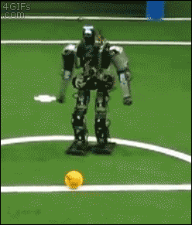
Questions?
Now get out there and move!

